Slide 1
Biotrade financing and funding Facilitated discussion
Dagmar Honsbein & Cyril Lombard GIZ BioInnovation Namibia & SA 14 September 2023

Slide 2
Financing Biotrade
Support on mapping, analysing and advising on financial instruments in South Africa and Namibia
African Biotrade Festival
14th September 2023
Dagmar Honsbein
Cyril Lombard
Notes:
Training on Access and Benefit-Sharing - Understanding Valorisation of Genetic Resources and User Sectors
from 9 to 11 March 2020 in Windhoek, Namibia

Slide 3
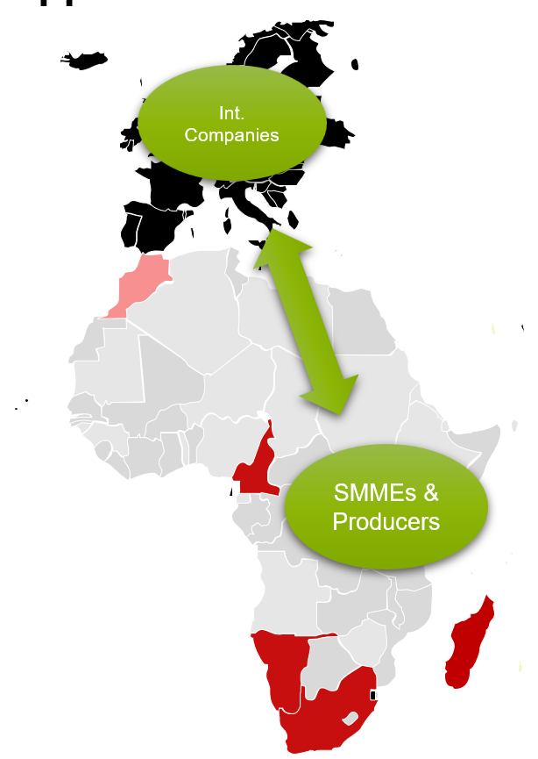
The BioInnovation Africa approach
Partnership approach of actors of transnational, biodiversity-based value chains (VCs):
from raw material producers to processors to manufacturers of end products
Increasing demand for biodiversity-based products with high ethical and ecological standards on the (European) market is the starting point for the partnerships
Triple win: rural development through green jobs/income, promotion of a sustainable private sector, (re-)investment in the conservation of biodiversity and livelihoods
Knowledge exchange (peer exchange)

Slide 4
BioInnovation Africa
Output 2
“Strengthening national capacities to promote biodiversity-based value chains and to reduce market barriers including ABS at national level”

Slide 5
Output 2
Address market barriers
Module
OUTPUTS
2) Capacities to promote biodiversity-based VCs and to reduce market barriers are strengthened at national level in the partner countries.

Slide 6
Approach to commercialisation
Responsive financial instruments
Responsible funding mechanisms
Being in support of value chains.

Slide 7
Funding needs along the value chain of our operators

Slide 8
Tasks of this activity
“Support on mapping, analysing, and advising on financial instruments in South Africa and Namibia”
Mapping of funds & forms of funding
Deliverable: funding & biobased investment market scoping report
2. Analysis on strengths and weaknesses and accessibility
Deliverable: SWOT report
3. Advise on gaps
Deliverable: appropriate funding mechanisms
4. Training and awareness
Deliverable: training materials, manuals, guidelines

Slide 9
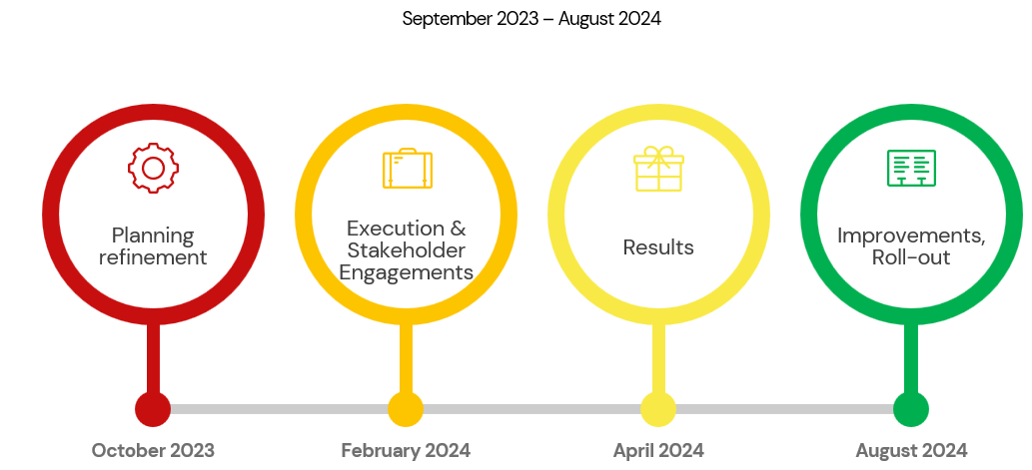
Envisaged timeline

Slide 10
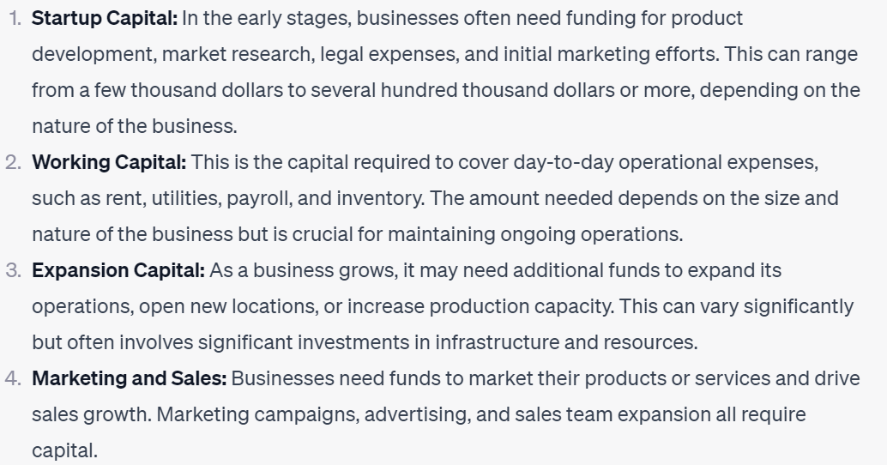
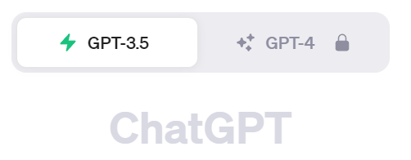
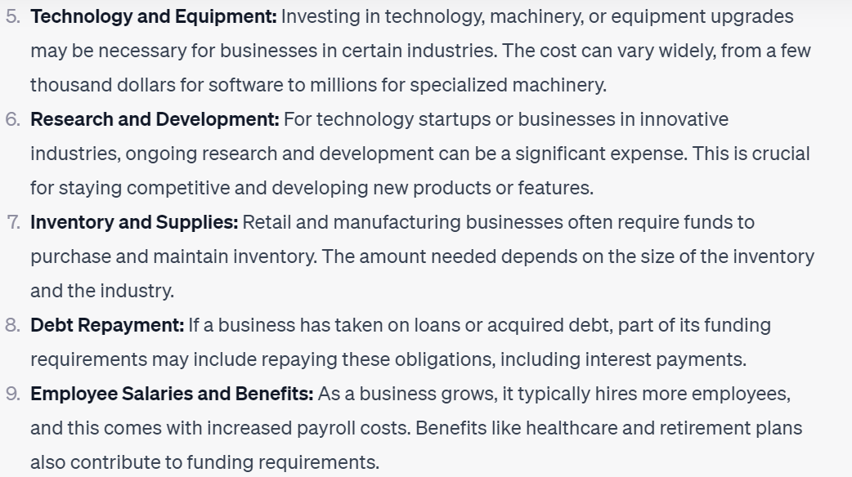
„Typical“ funding requirements?
What are the typical funding requirements of small, growing businesses?
Result: a long list of the usual suspects

Slide 11
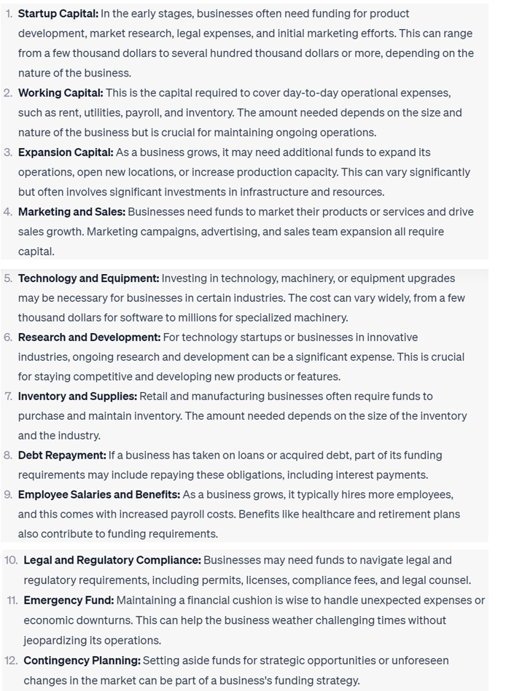
What are the „typical“ funding requirements of companies in the „biotrade“ sector
Plus
The usual suspects
ABS compliance including identifying and negotiating with holders of traditional knowledge
Fundamental science, applied science, R&D and innovation on new species and products
Building new supply chains with species that may not yet be selected and domesticated
Access to new markets with barriers protecting target market consumers and industries
Building industry and consumer awareness of completely new products
Plus………

Slide 12
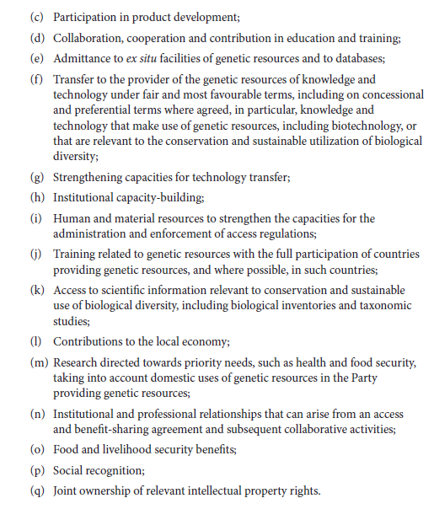
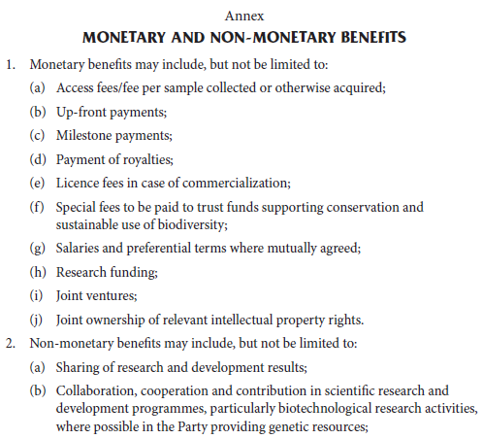
....The other Nagoya Protocol expectations

Slide 13
Our focus
A diverse funding and financing ecosystem for start-ups, SMMEs/SMEs, farmers, cooperatives, business support organisations, incubators, projects and programmes exists in South Africa and Namibia
However, anecdotal evidence suggests funding and financing instruments specifically for biotrade/bioprospecting businesses and support organisations; commercialization of products from our plant biodiversity, is limited
We plan to map this area of additionality (not the usual suspects)

Slide 14
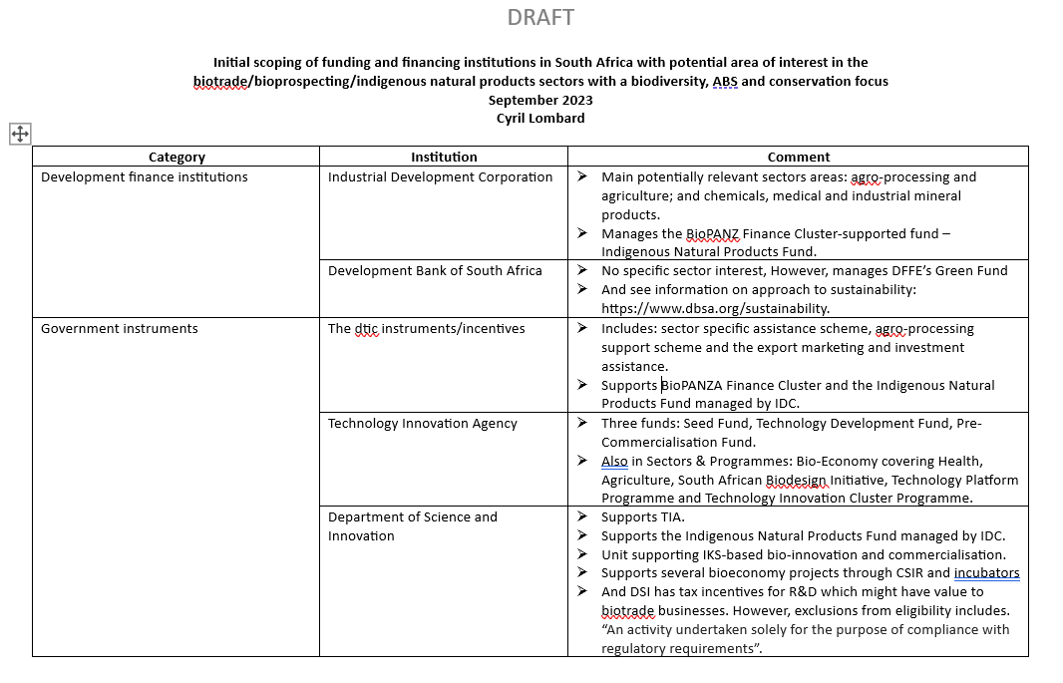
Progress in South Africa

Slide 15
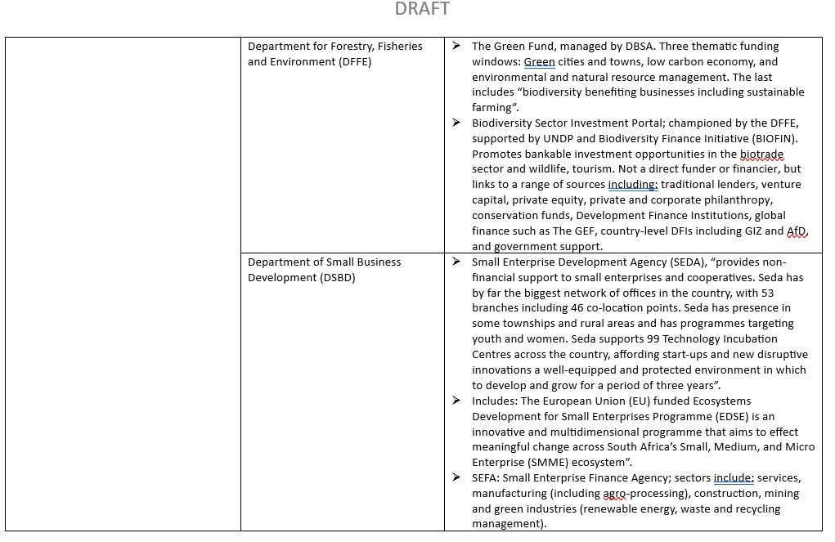
Progress in South Africa

Slide 16
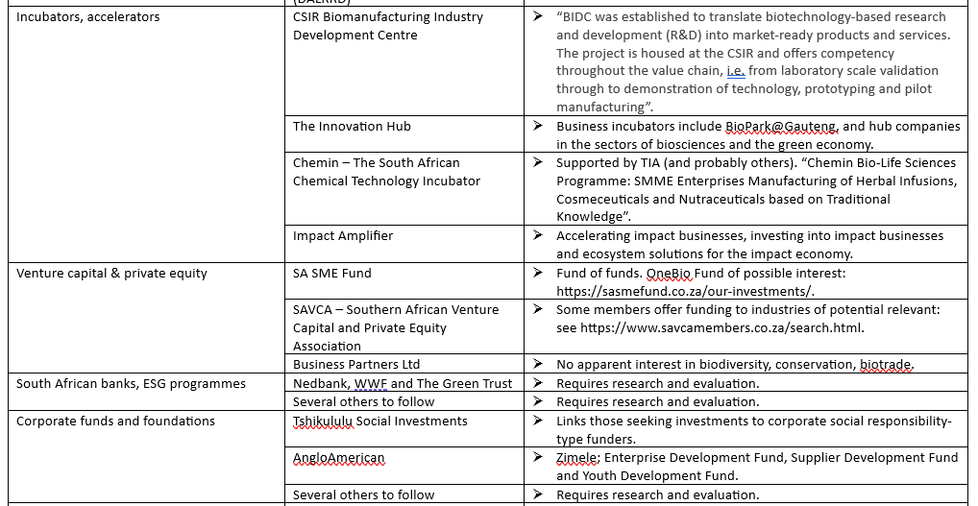
Progress in South Africa

Slide 17
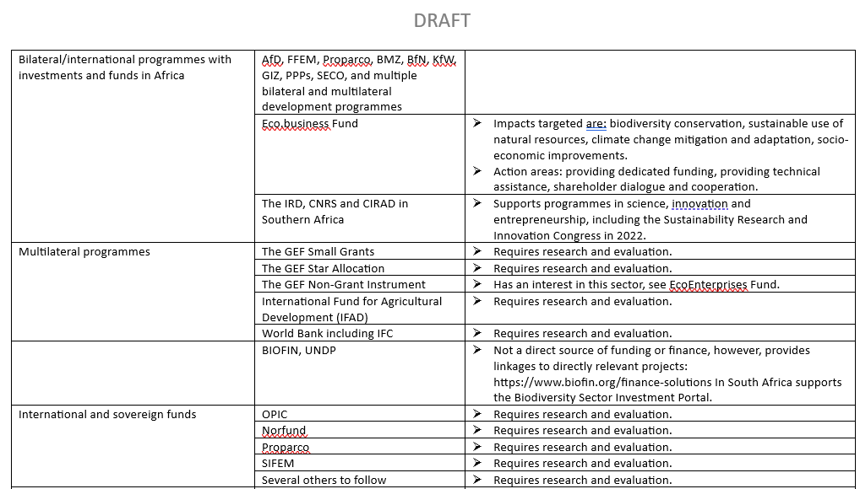
Progress in South Africa

Slide 18
Progress in South Africa

Slide 19
Question, comments and suggestions requested from stakeholders
Thank You

Slide 20
BioInnovation Africa project contacts

Slide 21
Implementation approach (new/old)
What will remain +/-: Staff concept, countries, implementation partners
(Meanwhile) less budget, less ressources, less partnerships (2/country) → focus
Shifts in focus:
Embedding biodiversity VC into wider context (GBF, NbS, NBSAPs) and portfolio (integrated solutions)
Gender higher „up“ in the VCs
Knowledge management, dialogue and institutionalization
More than ABS and ABS FPs, e.g. finance aspects → ABS as a means, not an end
Focus on existing partnership / new partnerships under additional funds
3 partnership categories:
(a) Continuation (initial budget) and (b) scale-up (additional funds) of „old“ partnerships
(c) New partnerships subject to a call for expression of interest
(d) Follow-up activities of terminated partnerships (sector-level, no regret,…)

